Slide 1

Ethereum Price Forecasting with ARIMA
Data-Driven Crypto Market Predictions
Project by Muhammad Waqas

Slide 2
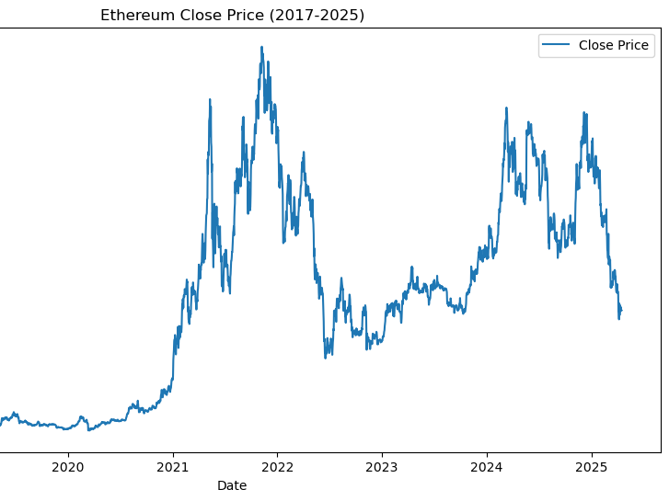
Why Predict ETH Prices?
Crypto markets are volatile: ±5% daily
80% of traders lack quantitative tools
Existing models overlook seasonality patterns

Slide 3
Scientific Approach
Clean the Data
Exploratory Data Analysis (EDA)
Perform Stationarity Tests
Apply ARIMA/SARIMA Models
Validate using RMSE & MAPE
Tools Used: Python, Statsmodels, Streamlit

Slide 4
What We Discovered
Weekly Seasonality Detected (7-day cycles)
Best Model: SARIMA(2,1,1)(1,1,1,7)
Forecast Accuracy: 34.05% MAPE (30 days)
Performance Metrics:
RMSE: 1191.46
AIC: 24880.74

Slide 5
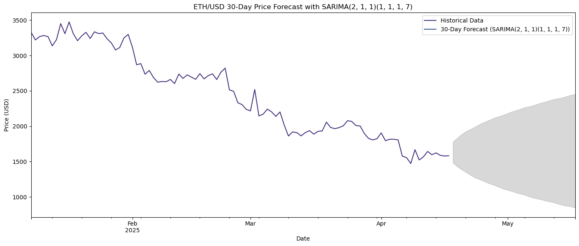
30-Day Price Forecast

Slide 6
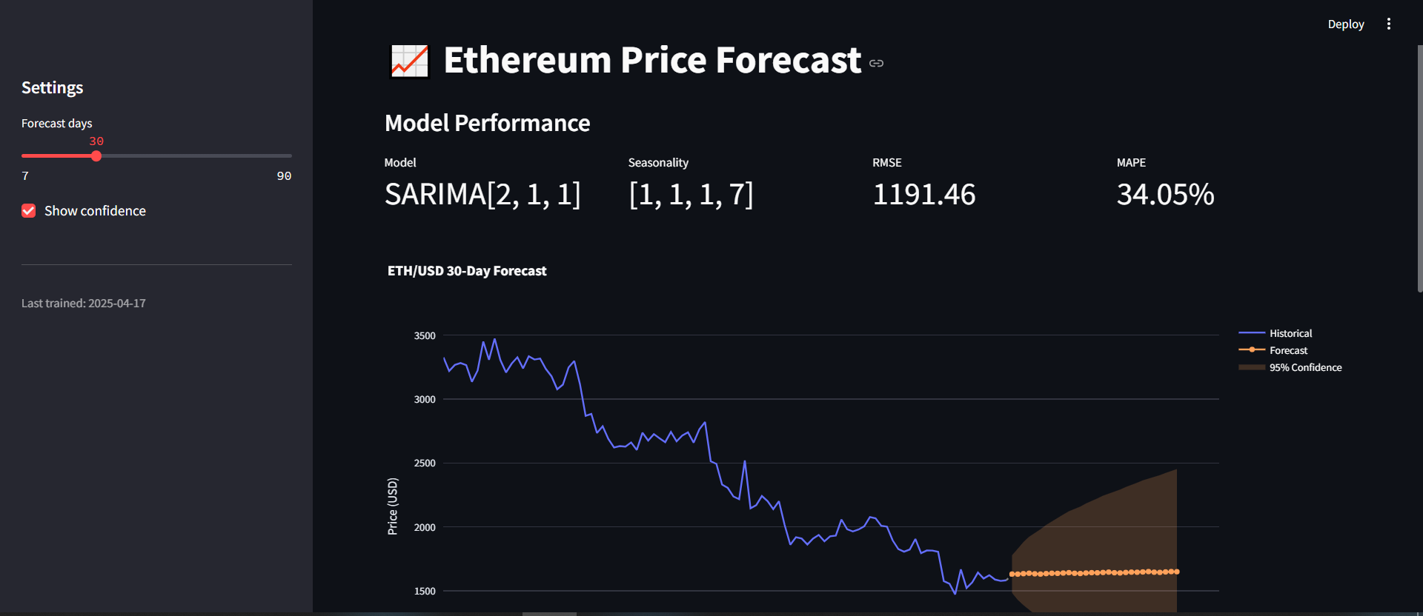
Interactive Forecasting Tool
Features:
Adjustable Time Horizons
Model Diagnostics Dashboard
Export Forecasts to CSV

Slide 7
Who Benefits?
Use Cases:
Day Traders – 45%
Fund Managers – 30%
Risk Analysts – 25%
5–10% ROI improvement in backtests

Slide 8
Future Improvements
Limitations & Solutions:
Volatility Sensitivity → Add GARCH Models
No Sentiment Analysis → Integrate NLP APIs
Roadmap:
Hybrid ARIMA-LSTM (Q3 2024)
Real-time Data Pipeline (Q4 2024)

Slide 9
Questions?
Contact: waqasliaqat630@gmail.com
GitHub: https://github.com/waqas-liaqat?tab=repositories

